Slide 1
Pauline Cairns
E21 – project brief – Shop inventory

Slide 2
Reports of shoplifting in convenience stores double in a year
Source: https://www.telegraph.co.uk/news/2018/03/20/reports-shoplifting-convenience-stores-double-year/
A report by the Association of Convenience Stores’ 2018 Crime Report has revealed that there were over 950,000 incidents of theft reported in corner shops over the last year, rising from 575,000 in the previous year.
It means more than 200 thefts are being reported an hour with many more going uncaught.
Notes:
https://www.telegraph.co.uk/news/2018/03/20/reports-shoplifting-convenience-stores-double-year/

Slide 3

Pauline
As a... | I want to... | so that...
new business owner | provide great customer service | I can make money by selling as many sweets as possible
new business owner | keep a watch on stock levels | I know how much working capital is tied up in stock
former Codeclan student | adopt technology to help staff do the admin side of the job as efficiently as possible | they can spend more time serving customers

Slide 4

Carolynne
As a... | I want to... | so that...
people person | provide great customer service | I can make people happy by selling them the sweets they want
shop manager | keep a watch on stock levels | I know how much stock is in the shop and can monitor when to reorder
individual who uses digital technology | adopt technology to make my job as easy as possible | I can free up time for other management tasks and serving customers

Slide 5
What’s on the stock app

Slide 6
Sweets Like Chocolate - Classes Database sweet_shop
Product
id – primary key product – varchar(255) description – varchar(255) stock quantity - int4 buying cost – int/number selling price – int/number supplier_id – int comments – varchar(255)
save update delete show-all supplier stock-level mark-up find
Supplier
id name – varchar(255) telephone_number – varchar(255)
save update delete show-all product find
One to many relationship as: - each product has only one supplier, but - one supplier could supply many products
Notes:
Telephone number is varchar as number not being used for numeric purposes.

Slide 7
To – do list
Add columns to adjust for stock written off with corresponding adjustment to current stock
Add links to reorder form or to supplier website to reorder online.

Slide 8
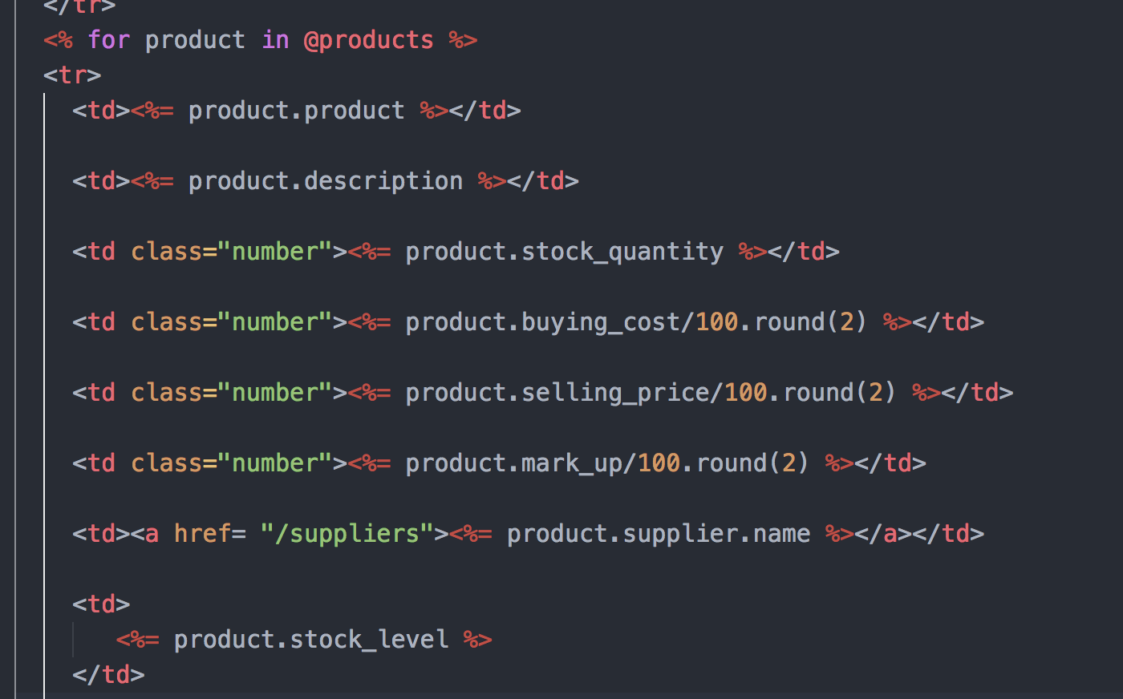

Slide 9
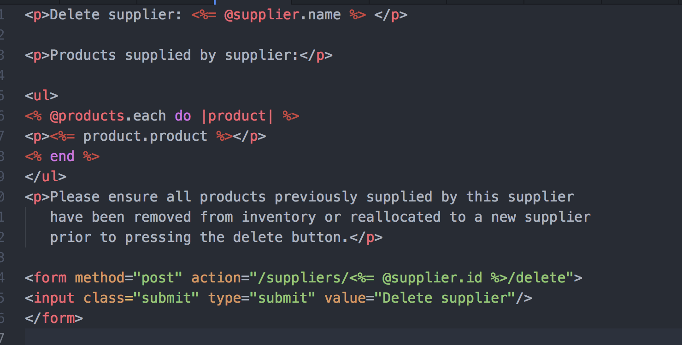

Slide 10
Lessons learned
Money difficult to work with – round will take off the last zero. Had to get input in pence which is not the most convenient method.
Linking tables by one to many causes issues if the parent is to be deleted but the children need to remain.

Slide 11
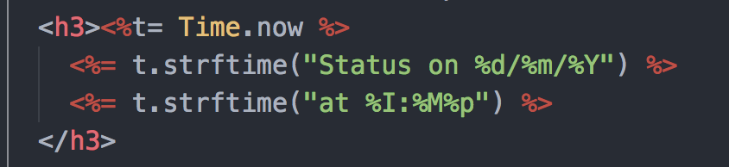
Features liked
Can see the current time and date on the stock status. Helpful for record keeping.

Slide 12
Questions

